Slide 1




PureSense
WHERE DATA DRIVES A CLEANER TOMORROW

Slide 2

Problem Statement
Our Team
System for Monitoring & Improving Air & Water Quality
Arjun Basandrai
Machine Learning
Air and water quality are vital factors that directly impact the health of our environment and communities. Monitoring and improving the quality of air and water resources is essential for ensuring a sustainable and healthy future. This hackathon challenge aims to develop innovative solutions that provide actionable insights and recommendations to mitigate pollution, reduce contaminants, and enhance the overall quality of air and water with the help of real time crowdsourced data and predictive modelling.
Shourya Jain
Machine Learning
Abhinav Ganeshan
Front-end development
Aman L
Back-end developement

Slide 3
Objective
PureSense is a web based solution that allows users to analyze real-time air and water pollution data. Our objective is to raise citizen awareness about air and water pollution. PureSense provides users with forecasts and insights about the air and water quality in their area. By leveraging real-time data, cutting-edge technology, and the collective power of communities, we seek to mitigate pollution, reduce contaminants, and enhance the overall quality of our environment. PureSense is about creating a world where clean air and water are not just ideals but a reality. Together, we're building a future where every individual's efforts count toward a cleaner and healthier planet.

Slide 4
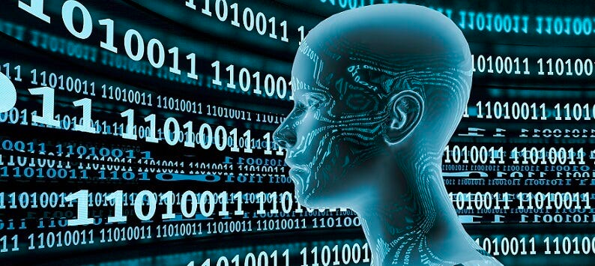


What sets us apart
Forecasting: Besides providing features to analyze present data, PureSense allows it users to forecast pollution trends and suggests optimal mitigation strategies.
Real-time analysis: PureSense provides users the ability to compare real-time data with past data and gain meaningful insights.
Community-driven service: PureSense allows users to submit air/water readings which are verified by the community before being added to the database

Slide 5
Complexity
Machine Learning
Machine learning algorithm for time-series analysis to study air and water quality data and forecast future pollution trends.
Frontend (NextJS)
A portal, where users can sign in and volunteer to work together for a better environment. Users can report the their concerns here.
Backend (Python FastAPI)
Link that connects between the Machine-Learning algorithm and portal. With use of python, API will be created which will then be called in frontend and used by users

Slide 6
Feasibility & Practicality
We're living in a tech-savvy era where sensors, data analysis, and community engagement are no longer futuristic dreams but everyday realities. Thanks to advancements in technology, the idea of collecting real-time environmental data is very straightforward. The ubiquity of smartphones and the increasing awareness of environmental issues mean that people are ready and willing to participate actively.
PureSense depends upon crowdsources data. We've designed it to translate complex data into straightforward, actionable recommendations that anyone can use. It's adaptable, to suit different regions and communities, making it a practical tool for environmental improvement. Use of efficient time-series analysis algortihms make PureSense extremely practical to forecast and analyse future trends in air and water pollution.

Slide 7
Sustainibility
PureSense aligns seamlessly with the Sustainable Development Goals, specifically in the realms of diminishing air and water pollution while ensuring equitable access to high-quality resources for all. Our model operates on a self-sustaining basis, thanks to the active participation of community members who contribute valuable data.
As time progresses, our model undergoes continuous refinement through the incorporation of fresh data generously contributed by our community of participants. This ongoing process not only elevates the accuracy of our predictive capabilities but also ensures a continuous stream of valuable insights for our users. Additionally, it plays a pivotal role in keeping our website abreast of the latest trends in pollution ratings.
In essence, PureSense is a community-driven solution that enriches the collective data contribution from society at large, leading to enhanced forecasting and richer insights for all our users.

Slide 8



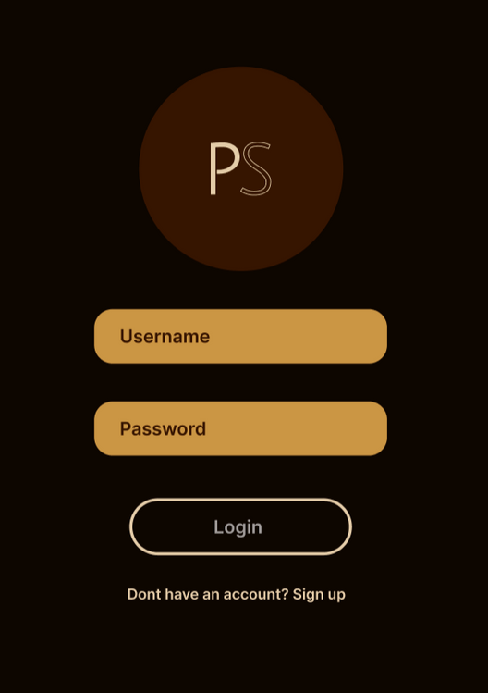
Scale of Impact
Our initiative is assured to have a significant nationwide influence through the utilization of data gathering and predictive analysis. Imagine millions of people actively participating in monitoring and improving air and water quality. Picture communities collaborating, making data-driven decisions, and taking action to reduce pollution and contaminants. It's a platform that empowers everyone, from urban centers to remote villages, to play a role in creating a cleaner and healthier environment
Individuals will be motivated to take proactive steps in mitigating air and water pollution as they gain access to real-time data that reveals the true state of affairs. This information will enable them to stay well-informed about the quality of air and water, ultimately inspiring greater engagement in our mission to enhance the quality of these vital resources.

Slide 9




User Experience
Easy to Use
Modern Design
Real-Time Feedback
Community Driven

Slide 10





FUTURE GOALS
Develop a mobile application to make the services more easily accessible
Recognize the causes of increasing pollution in the country and be able to provide innovative soll
Collaborate with local NGOs and schools to regularly test water samples from their area
Start awareness campaigns in under-developed areas and provide environmental education to people

